Slide 1
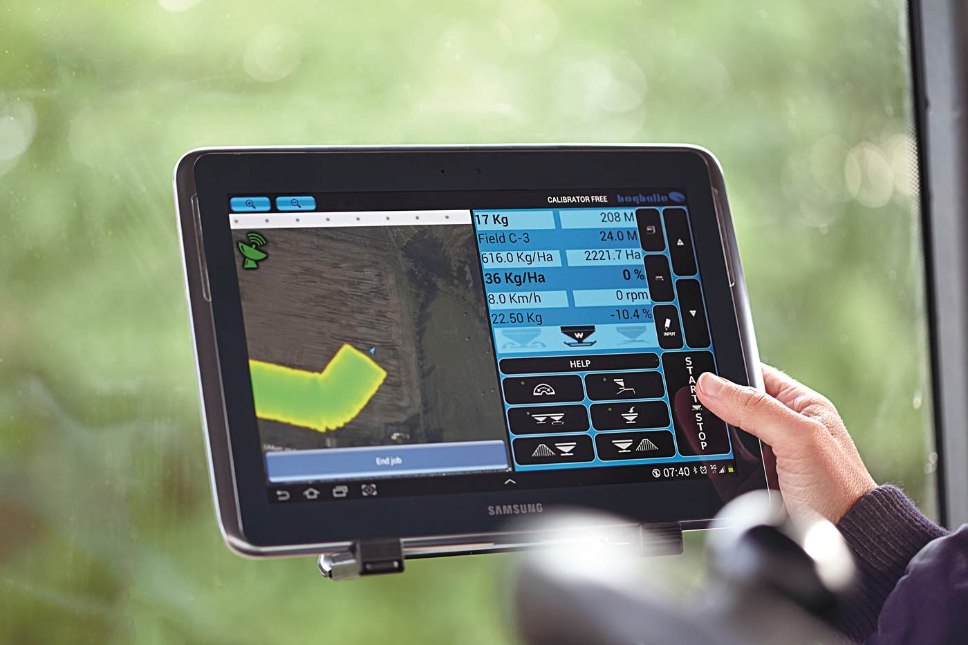
FREE Concept
FREE Concept
TABLET PRO SOUVRAŤOVOU AUTOMATIKU A OVLÁDÁNÍ SEKCÍ
Notes:
Please let me introduce you to the FREE Concept – a tablet based solution for automatic headland and section control.
We have made a solution for GPS based headland and section control with a standard tablet as the wireless interface between the spreader and the driver.
The fact that we use a standard tablet as an element in the FREE concept opens up to a world of opportunities and gives us access to all the well known and proven features,
which have been developed over years and today used by millions.

Slide 2
FREE Concept
Volnost pro farmáře
Nezávislý na značce traktoru a typu navigace!
Notes:
At the same time, with the FREE concept we want to give the farmer a FREE choice and let him be independent
independent from tractor brands and GPS brands when he chooses the best fertiliser spreader in the world.
With the FREE concept we give the choice to the farmer.

Slide 3
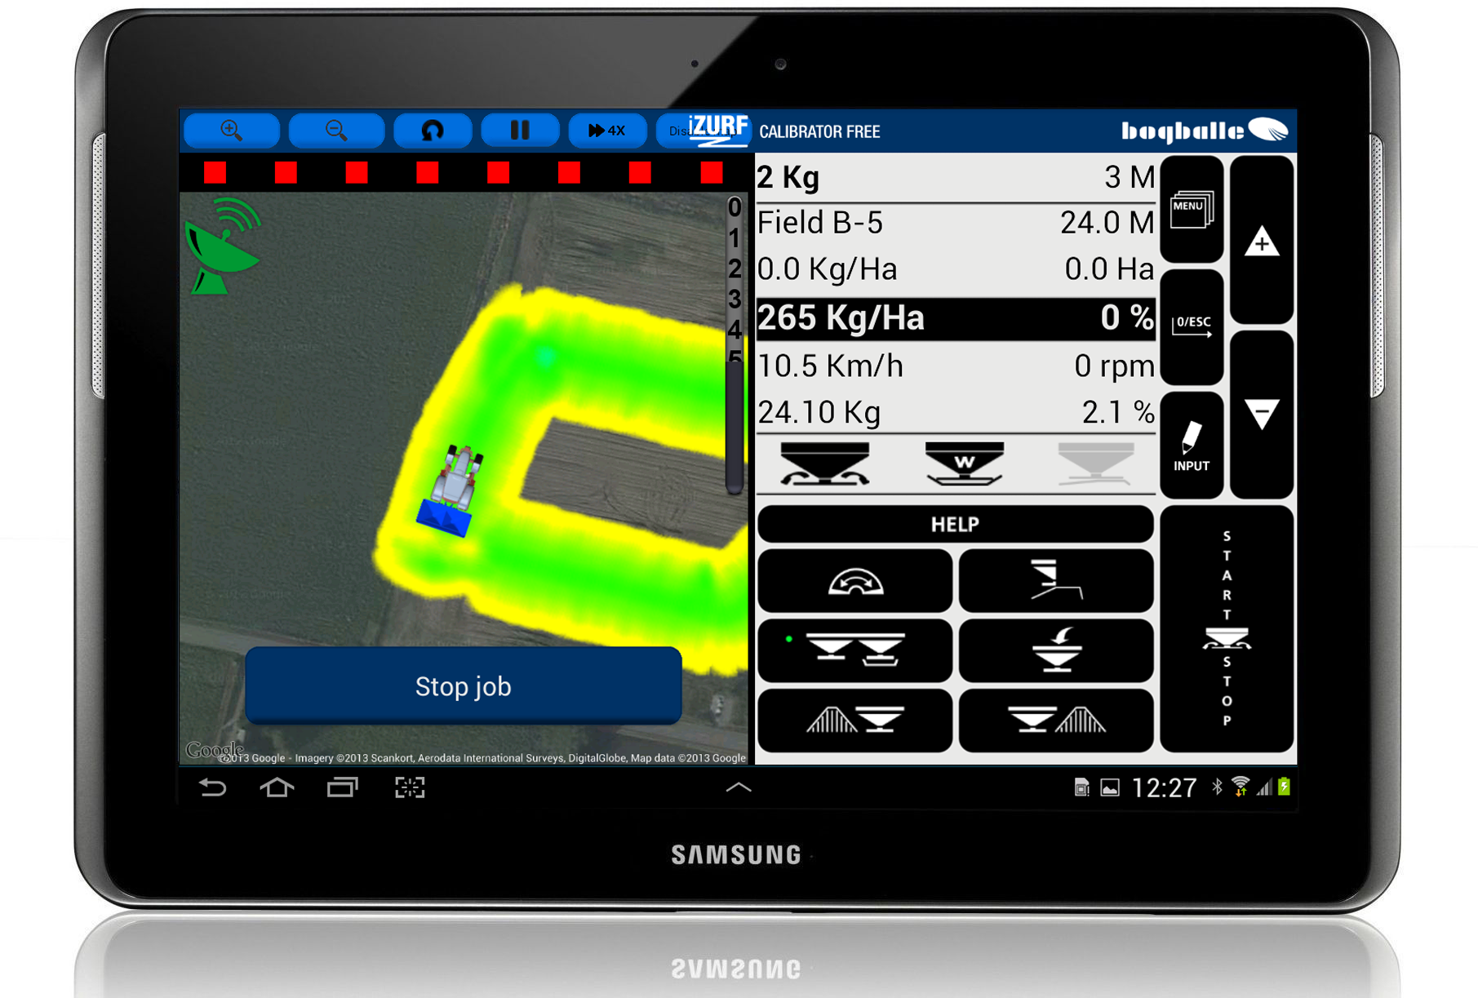
FREE Concept
DISPLAY:
Navigace
CALIBRATOR ZURF
Notes:
Now – I want to show you some of the basics of the FREE concept. Looking at the display it is divided into two sections.
On the right hand side a complete control display and a complete view of settings and working conditions – like on the CALIBRATOR ZURF.
On the left hand side a complete view of the headland and section control and the status of the GPS signal.

Slide 4
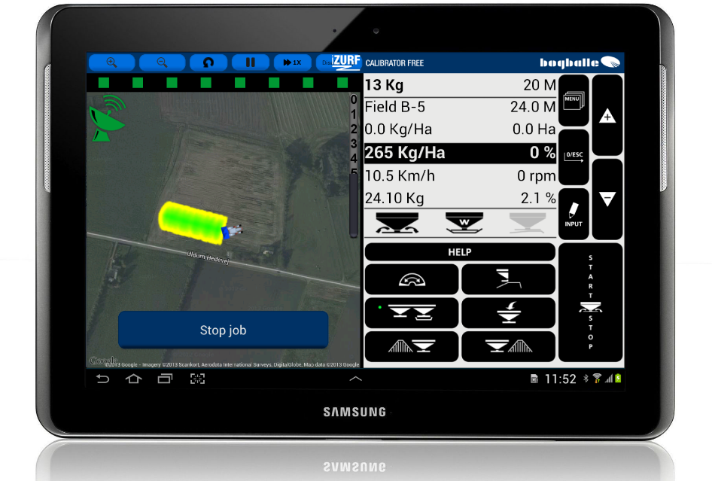
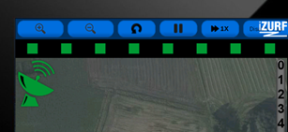
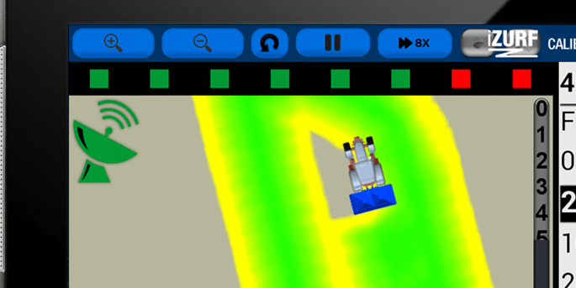
FREE Concept
Funkce:
Souvraťová automatika
Regulace záběru v klínech – 8 sekcí
Notes:
The main feature – GPS controlled headland and section control – gives the farmer high precision spreading with optimized start and stop points at headland and optimized regulation – both section control standard and section control dynamic – in wedges. We always work with 8 sections and the squares display very clearly in green which sections are open and in red which are closed

Slide 5

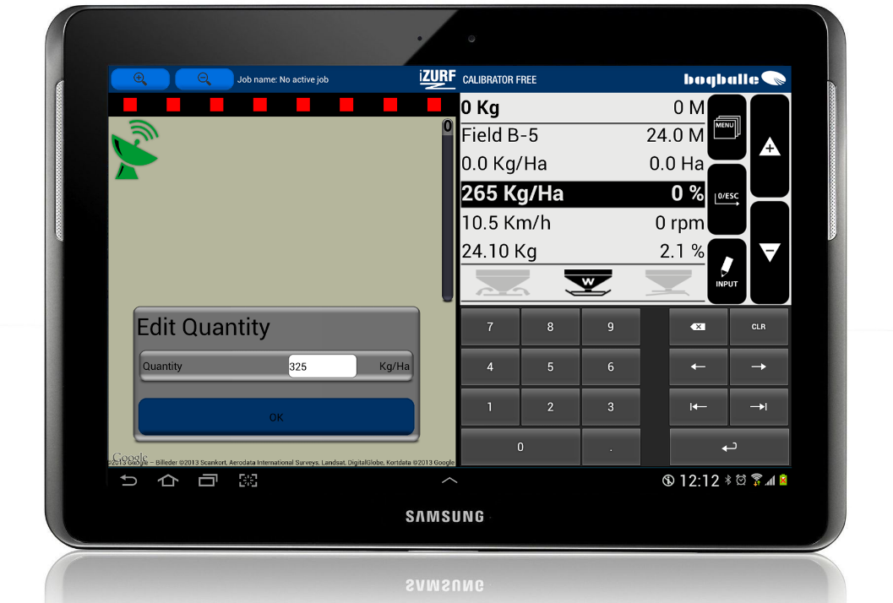
FREE Concept
Funkce:
Přehledná grafika display
Možnost řídit rozmetadlo a sledovat navigaci současně na jedné obrazovce
Moderní dotykový display
Nastavení rozmetadla přímo na display
Notes:
With the tablet solution you are given an excellent graphical display, which very clear and in bright colours allows the driver to follow the spreading
and at the same time have access to all controls.
The tablet solution also offers, as standard, an advanced touch display which f.ex. Enables the driver to enter settings directly on the display

Slide 6
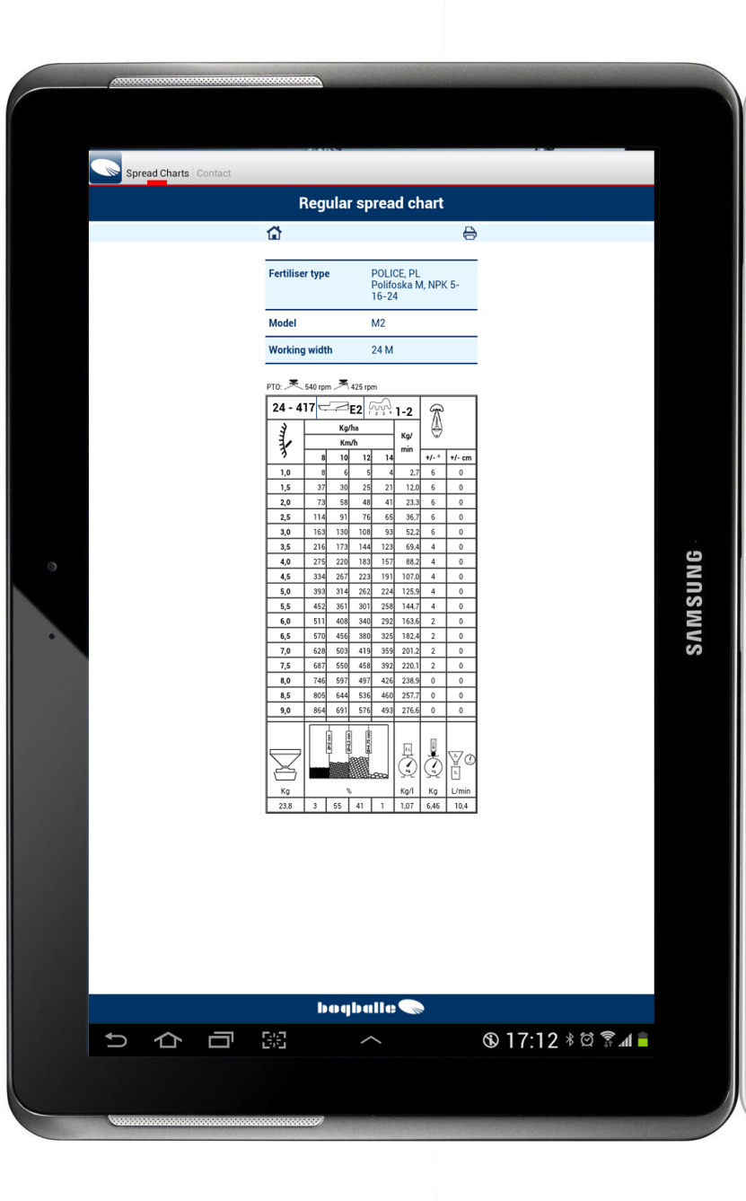
FREE Concept
Funkce:
S možností připojení k internetu:
    Přístup k rozmetacím tabulkám, instrukcím, emailu, předpovědi počasí...
    Po rozmetání možnost zaslání informací o vykonané práci emailem
Notes:
With the standard tablet many standard features are given which can ease the work for the driver.
With an internet connection it gives him online access to valuable information when he is in the field.
He has access to instructions, weather reports, emails, navigation and also a direct access to the spread charts on our web site.
With the online access the driver can send a job report per email when the spreading job is done and move on to the next job.
He does not have to write up all the details and remember to finish a report when he gets back from the field, all correct details ar reported immediately after the job is done.

Slide 7
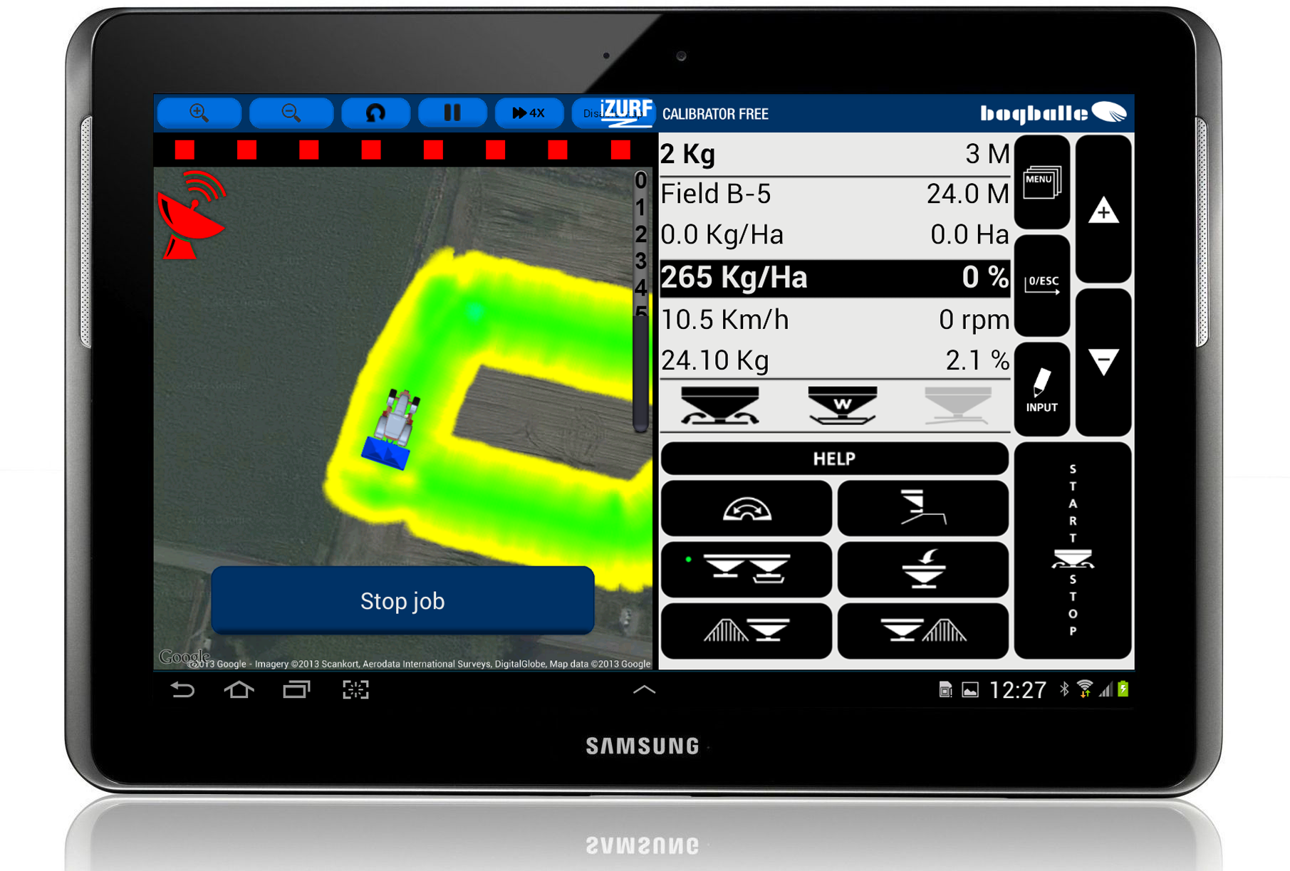
FREE Concept
Funkce:
Při ztrátě signálu
Bezdrátové řízení rozmetadla
- společně s automatickým SCD
Notes:
Some times a GPS signal can be lost (red satelite) – it can be in some specific areas where the signal is week, it can be when driving under some trees or if there in space is a so called ‘sun-storm’.
The FREE concept then offers a complete wireless control of the spreader if the GPS signal is lost.
The driver can control the spreader manually – also in wedges with section control dynamic if mounted on the spreader.

Slide 8
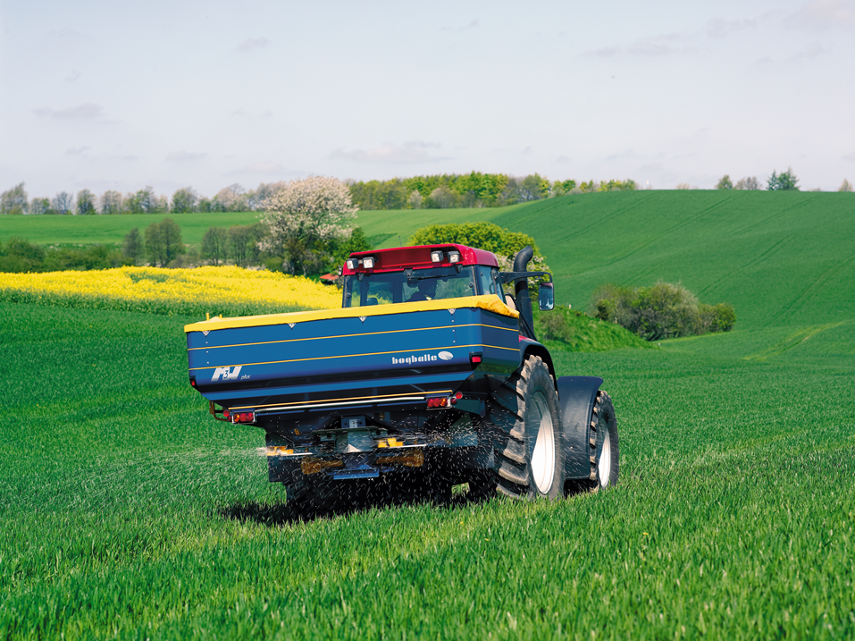
FREE Concept
Funkce:
Pro všechny W-rozmetadla s CALIBRATOREM ZURF
Notes:
The FREE concept is adaptable for all spreaders with a weighing system and a CALIBRATOR ZURF – that means for all W-machines.
And as a BOGBALLE speciality it is of course also adaptable for old weighing spreaders with an updated CALIBRATOR ZURF.

Slide 9

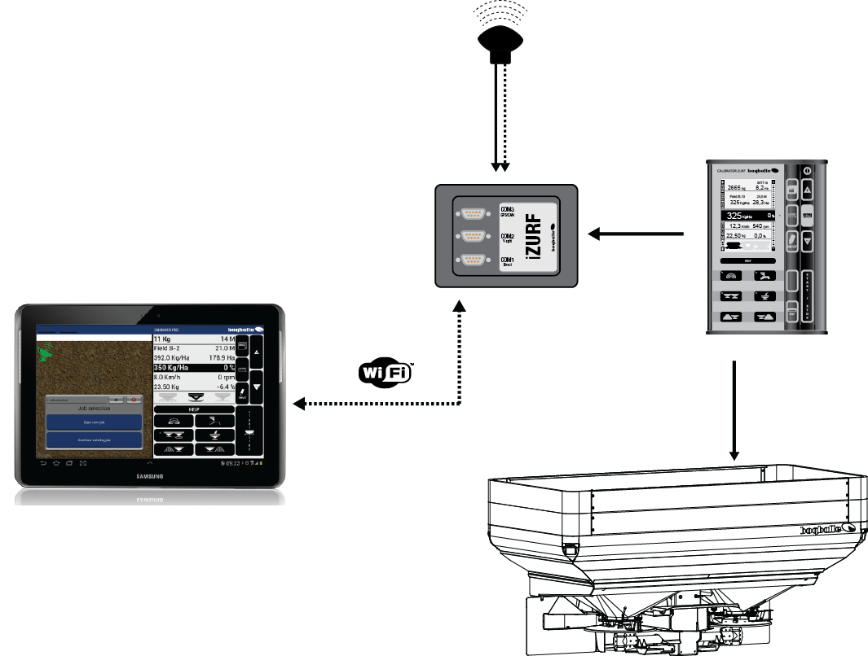
FREE Concept
Nákres zapojení
Standardní GPS antena
CALIBRATOR ZURF
iZURF
Komunikační modul
Standardní tablet
se zdarma staženou aplikací.
M6W
M3W
M2W
L2W
Notes:
The FREE concept is a system consisting of:
W-spreader, CALIBRATOR ZURF, iZURF communication module connected to the ZURF on the serial port, a standard GPS antenna - wired or wirelessly connected to the iZURF module.
A standard tablet with the BOGBALLE FREE app. – communication throuch WI-FI to the iZURF module.

Slide 10
FREE Concept
TECHNICKÁ SPECIFIKACE:
Standardní tablet
Android vers. 4.0 nebo vyšší
iZURF komunikační modul
COM3 Standardní GPS anténa
COM2 Sériové připojení, např. pro VRA
COM1 Sériové připojení, např. pro další GPS System
CALIBRATOR ZURF má pouze jeden port pro sériovou komunikaci a tak může iZURF komunikační modul sloužit jako rozbočovač.
Výrobní číslo: 6386-30
Notes:
The are some technical specifications which are important for you to know.
For the first release of the FREE concept the standard tablet must be an Android Tablet with version 4.0 or higher.
The Tablet is NOT available at BOGBALLE – it is a standard tablet.
The iZURF communication module has a serial connection for the CALIBRATOR ZURF, a USB port for power (connection to the CALIBRATOR ZURF) and three RS232 Communication ports.
One serial connection for a wired GPS antenna and two serial connections for Variable Rate Application and/or 3rd. Party GPS systems.
This means that the iZURF communication module can serve as a Y-splitter for the CALIBRATOR ZURF – also without the tablet solution.

Slide 11

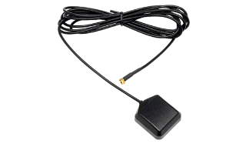
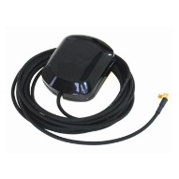
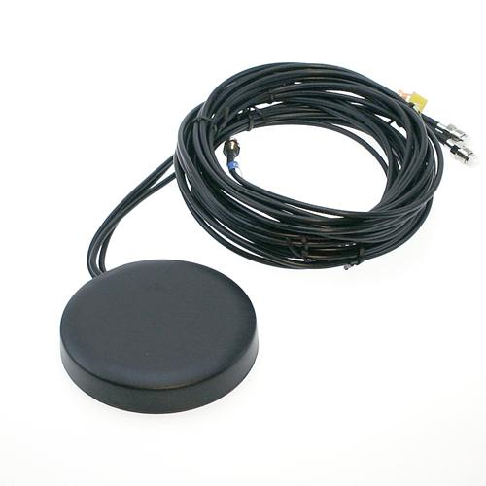
FREE Concept
TECHNICAL SPECIFICATIONS:
FREE App
Stáhnout z Google Play
CALIBRATOR FREE
Standardní GPS Anténa
S kabelem nebo bezdrátová
Připojení: Serial RS232
Protokol: NMEA-0183
Přesnost: Lepší, než 1 m
CALIBRATOR ZURF Verze softwaru 1.14 nebo vyšší
Notes:
The FREE App. - which is the program needed on the tablet - will be downloadable from Google Play – and it will of course be for FREE.
The standard GPS Antenna can be wireless or wired and must fullfill a few technical requirements:
It must be with a serial connection,
it must be based on the NMEA-0183 protocol and it must have a precision better than 1 meter.
The GPS antenna is not available at BOGBALLE.
The CALIBRATOR ZURF must have the software version 1.14 or higher.

Slide 12
FREE Concept
DELIVERY SCHEDULE:
Možnost stažení:
Pro Android – leden 2014
Pro další iOS/Apple – 2014…….
CALIBRATOR FREE
It is ready for delivery
- FREE concept in January 2014
- as Y-splitter now
Notes:
Now – let me introduce you to our delivery schedule:
The FREE App will be accessible on Google Play in January 2014 for tablets with the Android system.
For tablets from Apple with the iOS system the FREE App will be available in 2014, most likely at the end of 2014……..
The iZURF Communication Module is ready for delivery – for the FREE concept it is usable in January 2014
But as a Y-splitter to combine f.ex. a N-sensor and a GPS system it is usable now.

Slide 13
FREE Concept
VÝHODY:
Volná volba pro farmáře
Nezávislé na typu GPS a značce traktoru
Přehledný a jednoduše ovladatelný display
Používání známých tabletů od prověřených výrobců
Možnost používání mimo kabinu traktoru
Online připojení
Malé pořizovací náklady
Použití pro všechna rozmetadla s váhou – jak nová tak momentálně používaná – s CALIBRATOREM ZURF
Notes:
Just to sum up before you can try it hands on
We give the farmer the FREE choice – he is independent from GPS and tractor brand
We give the farmer a user friendly and familiar interface
We make use of wellknown and proven expert knowledge
We offer the wireless control of the spreader
We give the driver online access to valuable information in the field
We offer the possibility to be independent and still have the benefit of high precision spreading for a small investment
We offer the FREE concept to new spreaders but also to customers that already have invested in a BOGBALLE spreader.

