Slide 1
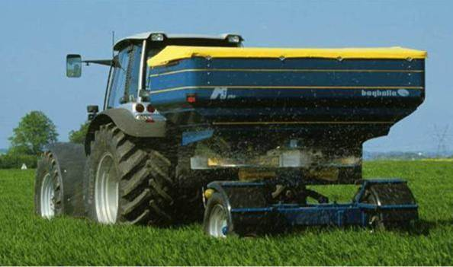
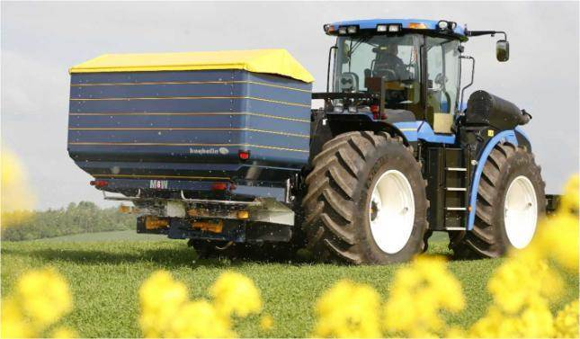
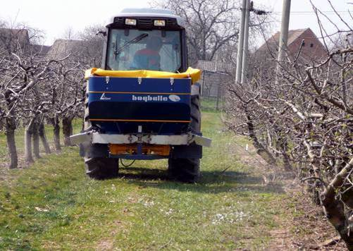
Rozmetadla Bogballe
3 základní argumenty

Slide 2
Nákup nového rozmetadla?
Záběr (12-42m)
Objem (0,5-6m³)
Výbava počítač, váha, navigace, klíny, kardan, hydropohon
Cena

Slide 3
Rozhodování
CENAA !!?
Argumenty???

Slide 4
Agrumenty
Záběr?
Objem ?
Výbava?
Cena

Slide 5
Argumenty
Rovnoměrnost aplikace
Hraniční hnojení - TREND
Jednoduchost a provozní spolehlivost

Slide 6
Rozmetání při rotaci od sebe
①
②
③
⑤
⑤
Notes:
Boom vs. Centrifugal principals.
24 metre working width
Boom covers about 24 m² – in a snap shot / split second.
BOGBALLE covers about 1.800 m² – or an area of about 75 times more.
On top of that, the idea of an centrifugal system is to overlap as much as possible – adding even more forgiveness by overlapping.
A Boom has three statuses: Exactly spot on – no overlapping = 0% applied and overlapping = 100%
A spreader has a number of unlimited statuses.
For those of you who do not agree – this 3D printed spread pattern might convince you.

Slide 7
Rozmetání plošné
Notes:
Boom vs. Centrifugal principals.
24 metre working width
Boom covers about 24 m² – in a snap shot / split second.
BOGBALLE covers about 1.800 m² – or an area of about 75 times more.
On top of that, the idea of an centrifugal system is to overlap as much as possible – adding even more forgiveness by overlapping.
A Boom has three statuses: Exactly spot on – no overlapping = 0% applied and overlapping = 100%
A spreader has a number of unlimited statuses.
For those of you who do not agree – this 3D printed spread pattern might convince you.

Slide 8
Rotace dostředná
Left disc 50%
Right disc 50%
One zone only
Triangle
Flexible overlapping between tramlines

Slide 9
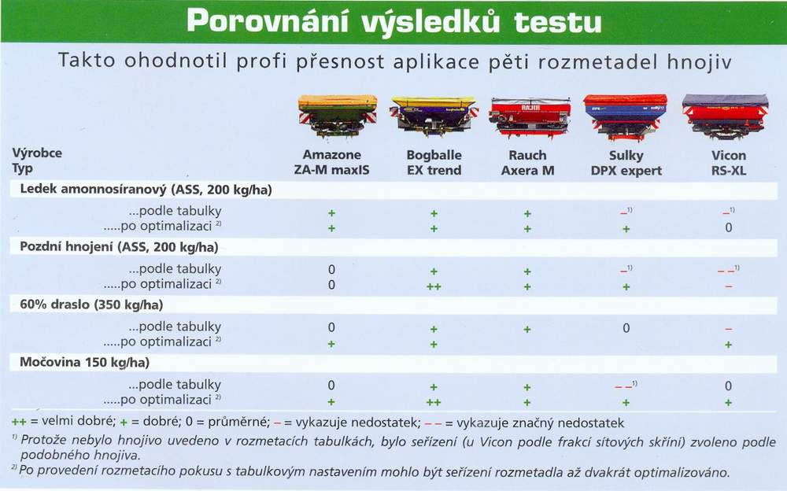
BOGBALLE x konkurence
Záběr 24 m
Notes:
The risk of not acting correctly – automatically controlled or manually – is low and uncomplicated.

Slide 10
BOGBALLE x konkurence
Jaro 2011
Záběr 36 m

Slide 11
Argumenty
Rovnoměrnost aplikace
Hraniční hnojení - TREND
Jednoduchost a provozní spolehlivost

Slide 12
Hraniční hnojení
24 m
12 m
One zone only
Triangle
Flexible overlapping between tramlines

Slide 13
PRAVOU stranou k hranici pole
Notes:
Boom vs. Centrifugal principals.
24 metre working width
Boom covers about 24 m² – in a snap shot / split second.
BOGBALLE covers about 1.800 m² – or an area of about 75 times more.
On top of that, the idea of an centrifugal system is to overlap as much as possible – adding even more forgiveness by overlapping.
A Boom has three statuses: Exactly spot on – no overlapping = 0% applied and overlapping = 100%
A spreader has a number of unlimited statuses.
For those of you who do not agree – this 3D printed spread pattern might convince you.

Slide 14
Trend_{concept}
Hraniční hnojení
From tramline
TO BORDER
NORMAL_{spreading}
HEADLAND_{spreading}
NORMAL_{spreading}

Slide 15
Rozmetání při rotaci od sebe
①
+
②
=
③
Notes:
Boom vs. Centrifugal principals.
24 metre working width
Boom covers about 24 m² – in a snap shot / split second.
BOGBALLE covers about 1.800 m² – or an area of about 75 times more.
On top of that, the idea of an centrifugal system is to overlap as much as possible – adding even more forgiveness by overlapping.
A Boom has three statuses: Exactly spot on – no overlapping = 0% applied and overlapping = 100%
A spreader has a number of unlimited statuses.
For those of you who do not agree – this 3D printed spread pattern might convince you.

Slide 16
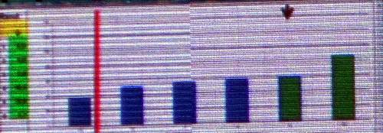
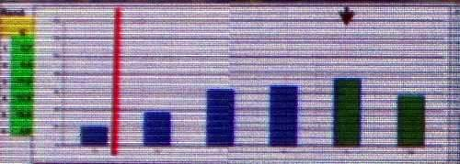
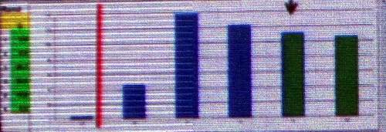
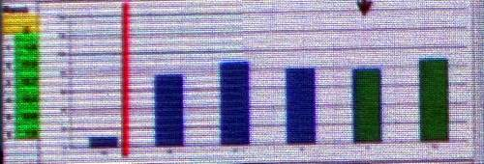
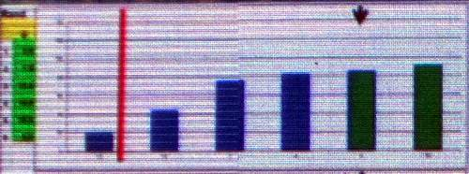
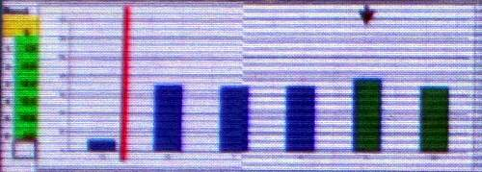
BOGBALLE x konkurence
Hraniční hnojení - DLG Bernbugr 2014
Amazone ZA-TS - hran. lopatka otáčky kotouče
Sulky TRIBORD 3D – hran. lopatka
Rauch Axis - deflektor
Bogballe M2W – změna rotace Trend
Záběr 24 m
Vicon RotaFlow EDW - deflektor
Bredal – otáčky kotouče

Slide 17
Argumenty
Rovnoměrnost aplikace
Hraniční hnojení - TREND
Jednoduchost a provozní spolehlivost

Slide 18
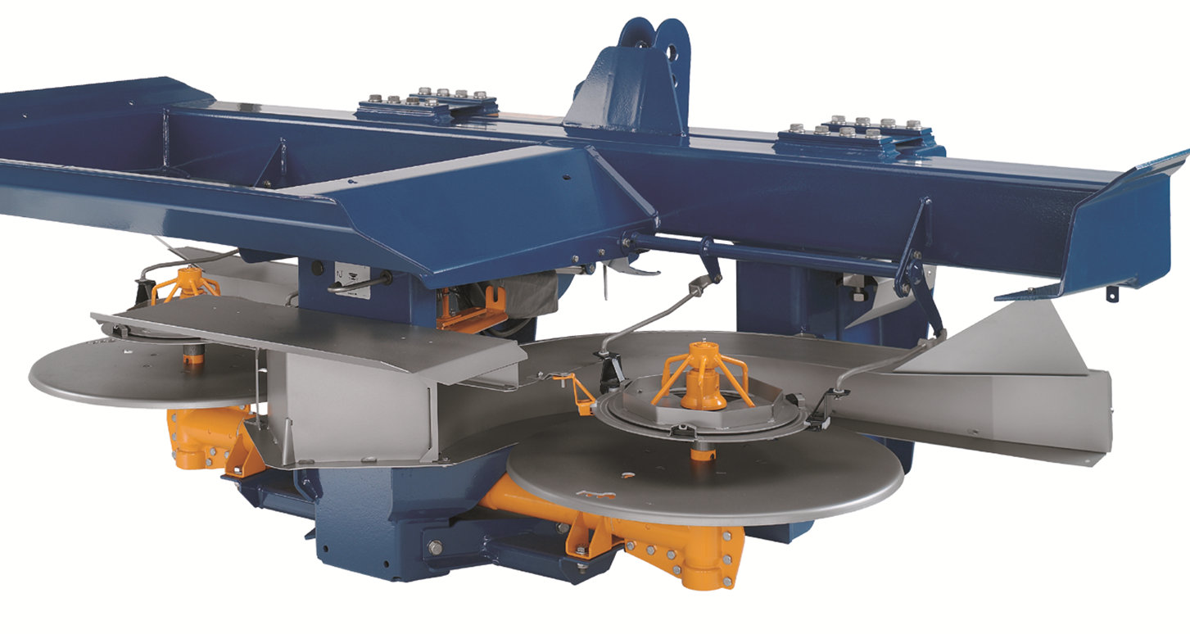
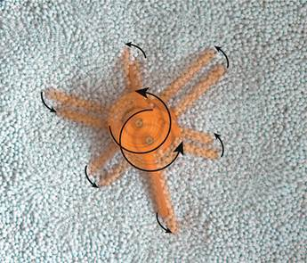
Jednoduchost

Slide 19
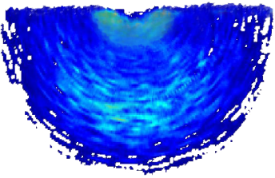
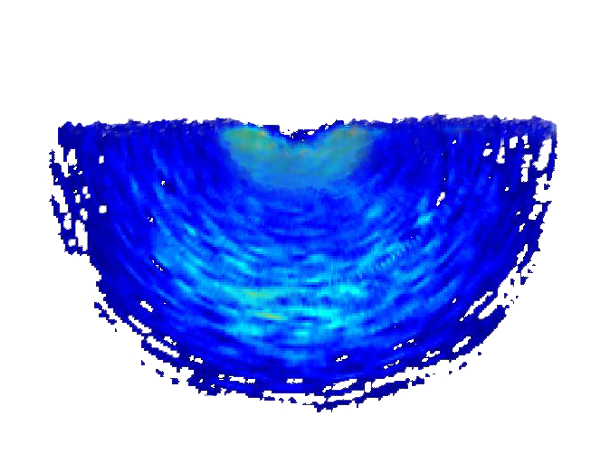
Lopatky - záběry
E1T záběr 12 – 18 m
E2T záběr 20 – 24 m
E6T záběr 28 – 36 m
E8T záběr 36 – 42 m
A2T záběr 10 – 15 m pro L1
A3T záběr 18 m pro L1

Slide 20
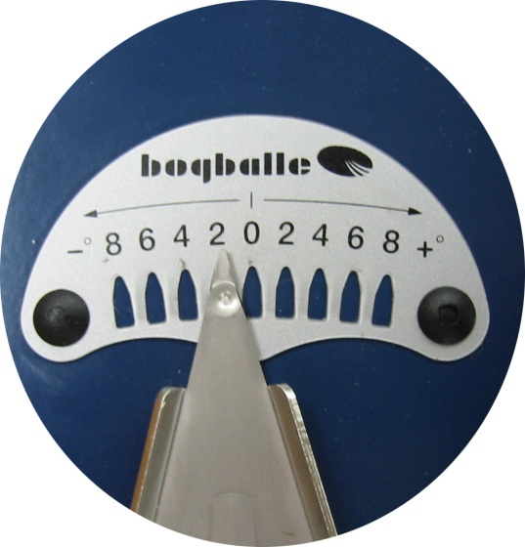
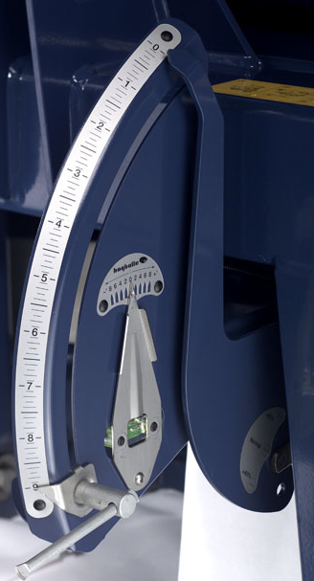
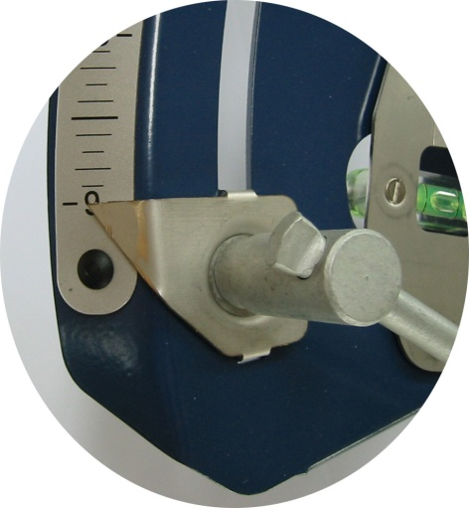
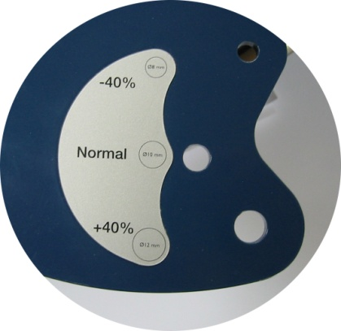
NASTAVENÍ
Nastavení sklonu
Nastavení dávky
Úrovně dávkování

Slide 21
Děkuji za pozornost

